Slide 2
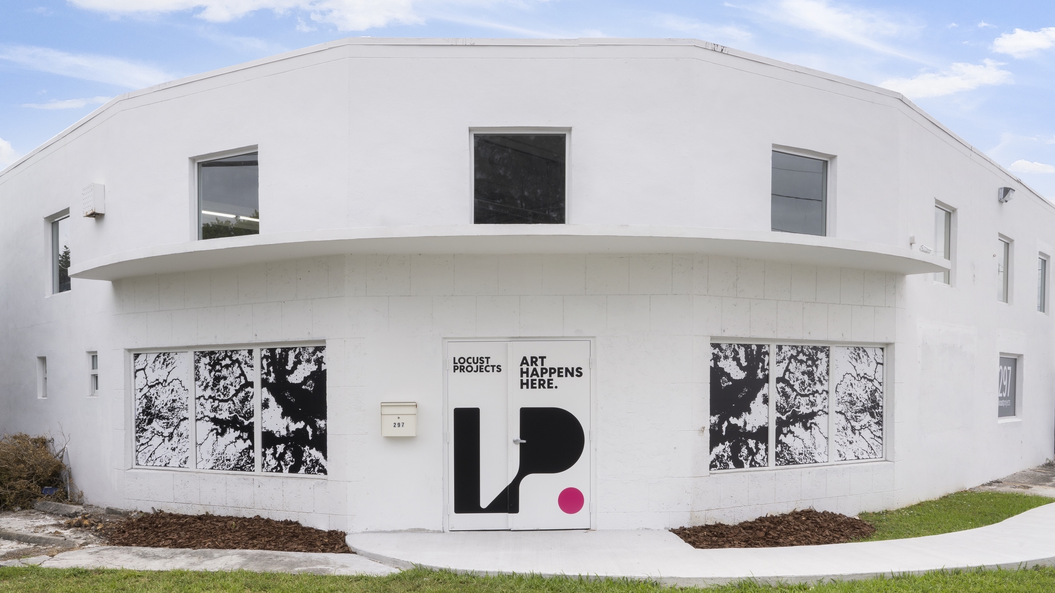

Slide 4
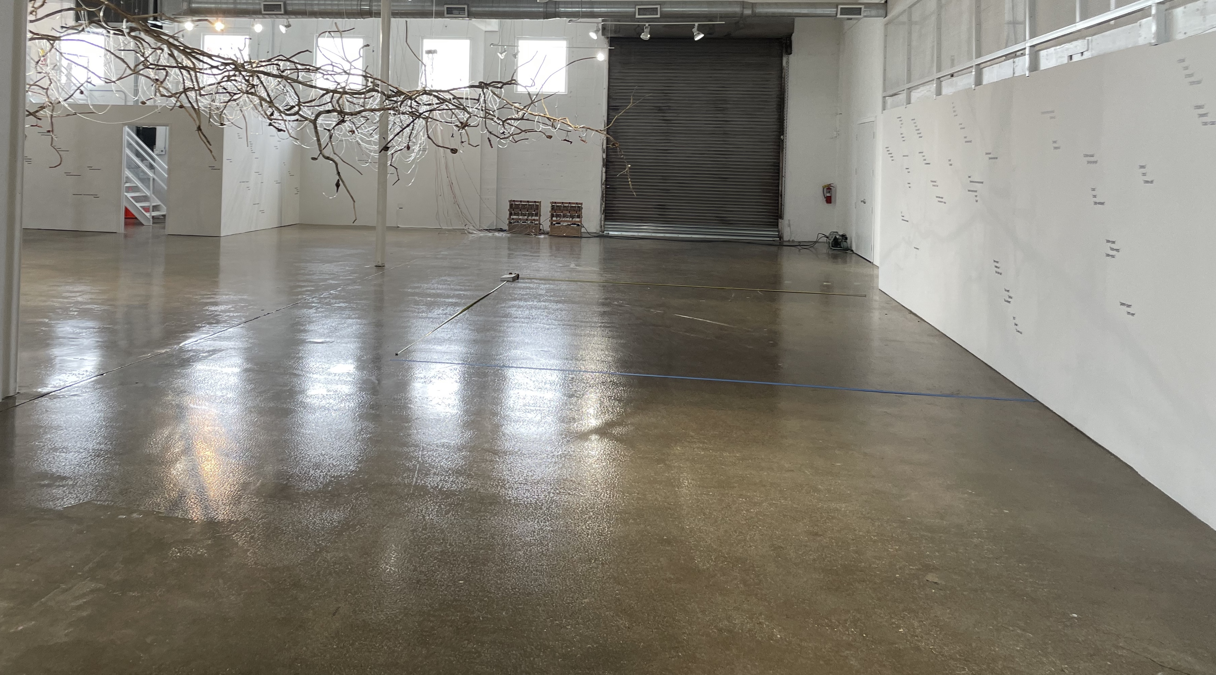
FOUNDED BY ARTISTS FOR ARTISTS IN 1998
Locust Projects’ new 8,000 sq. ft. home in Little River features a rotating schedule of site-specific installations by an array of local, national and international artists in the Main Gallery, Project Room and Screening Room/DiLL. Selected artists will have access to studio work space in the months prior to their project opening.

Slide 5
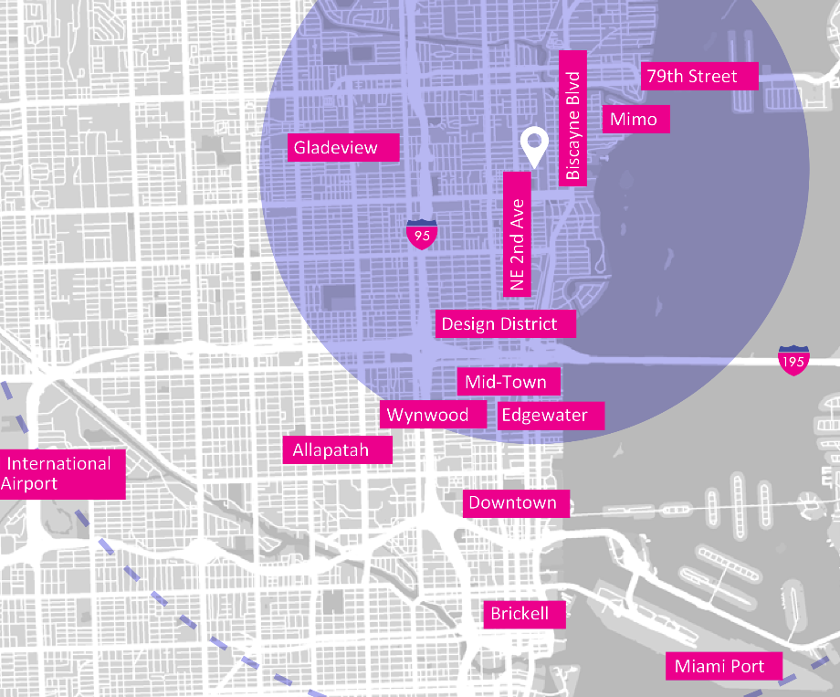
LOCATION
Located in Little River/Little Haiti’s industrial neighborhood off NE 2nd Avenue and 67th Street, Locust Projects is close to the Design District, MiMo, Wynwood, Miami Beach, and Miami International Airport and 8 miles to South Beach.

Slide 6
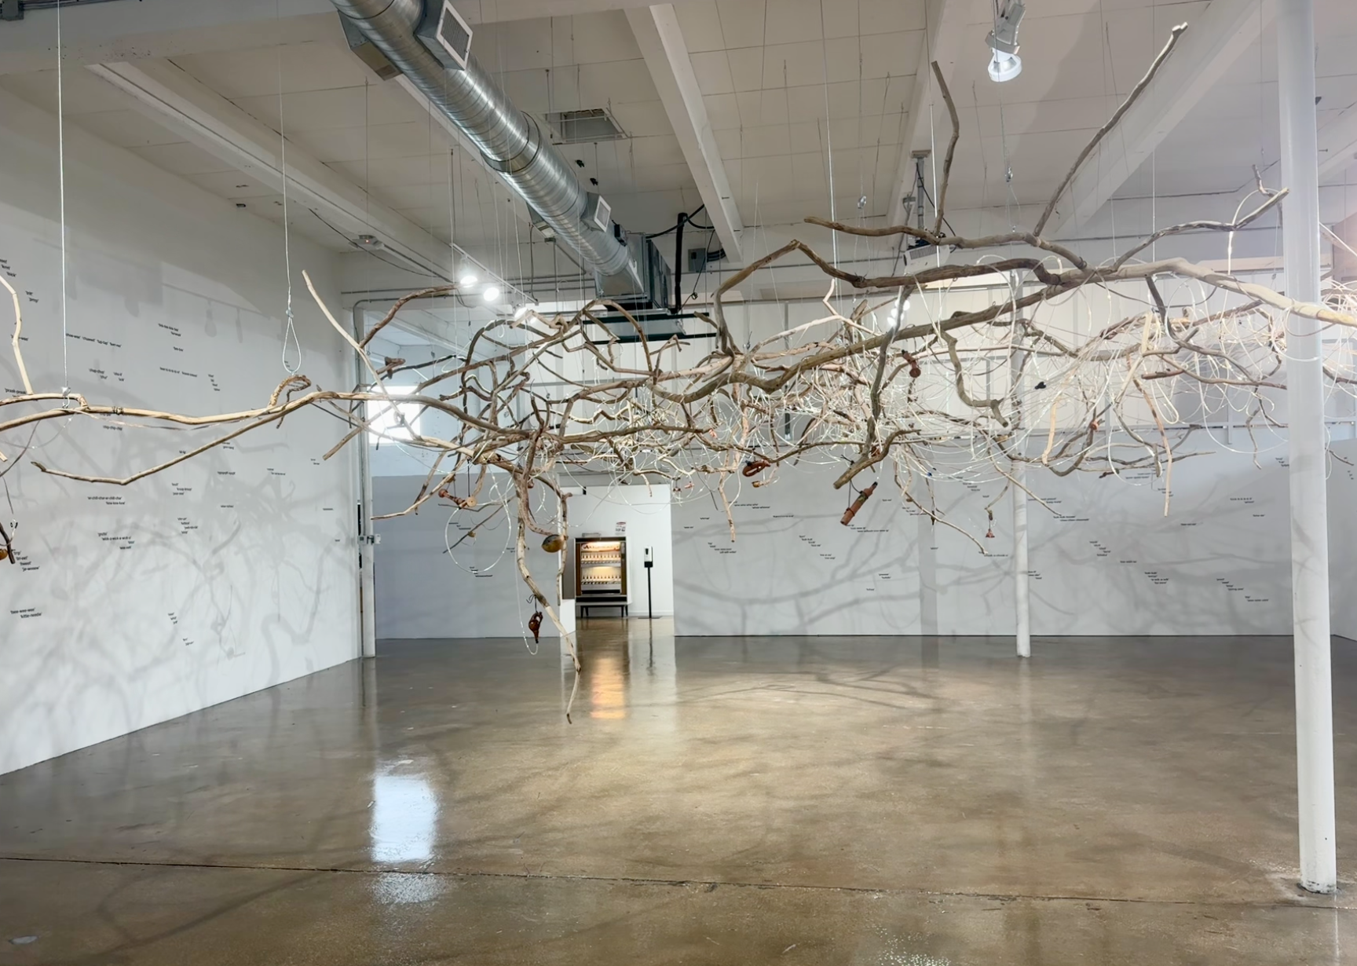
MAIN GALLERY
Approximately 2,500 sq ft

Slide 7
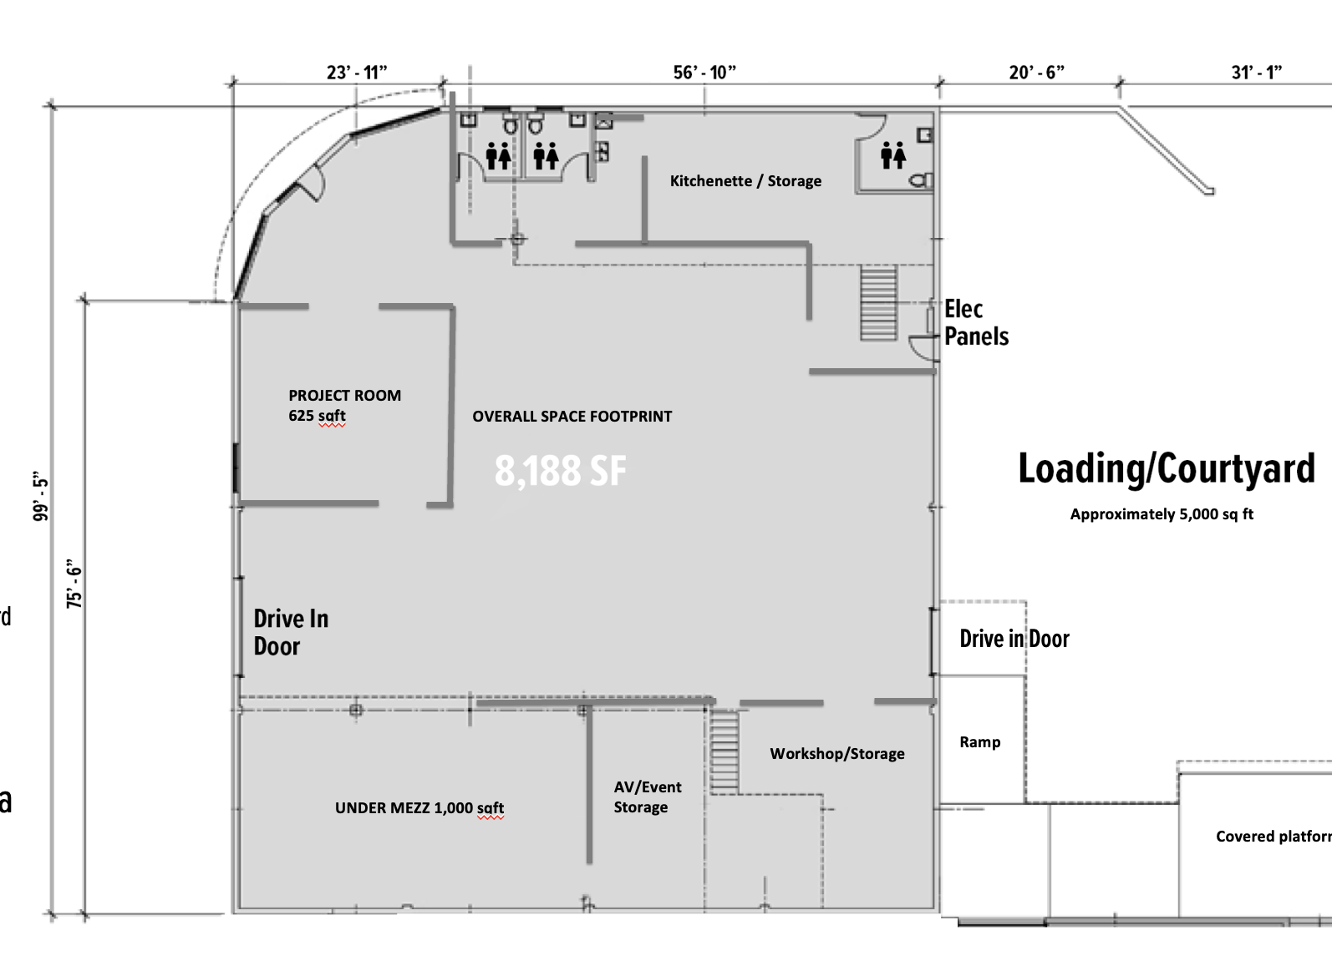
ABOUT THE SPACE
Ceiling height: 17'
ADA Restrooms: 2 public; 1 private
Kitchenette, prep area, lockers
Two loading bays / roll-up doors
Entrance/lobby
MAIN EXHIBITION SPACE
Approx 2,550 sq.ft.

Slide 8
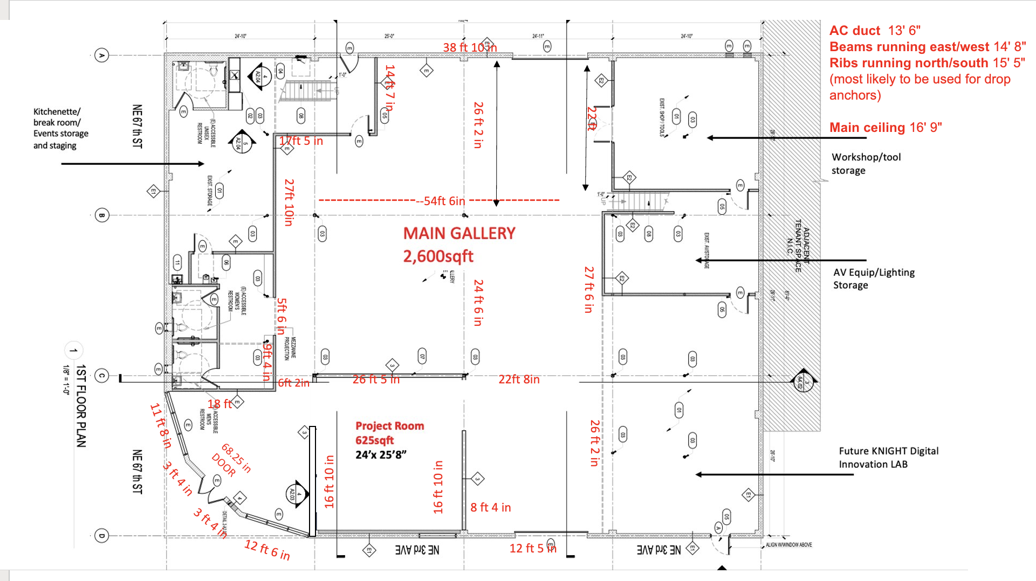

Slide 9
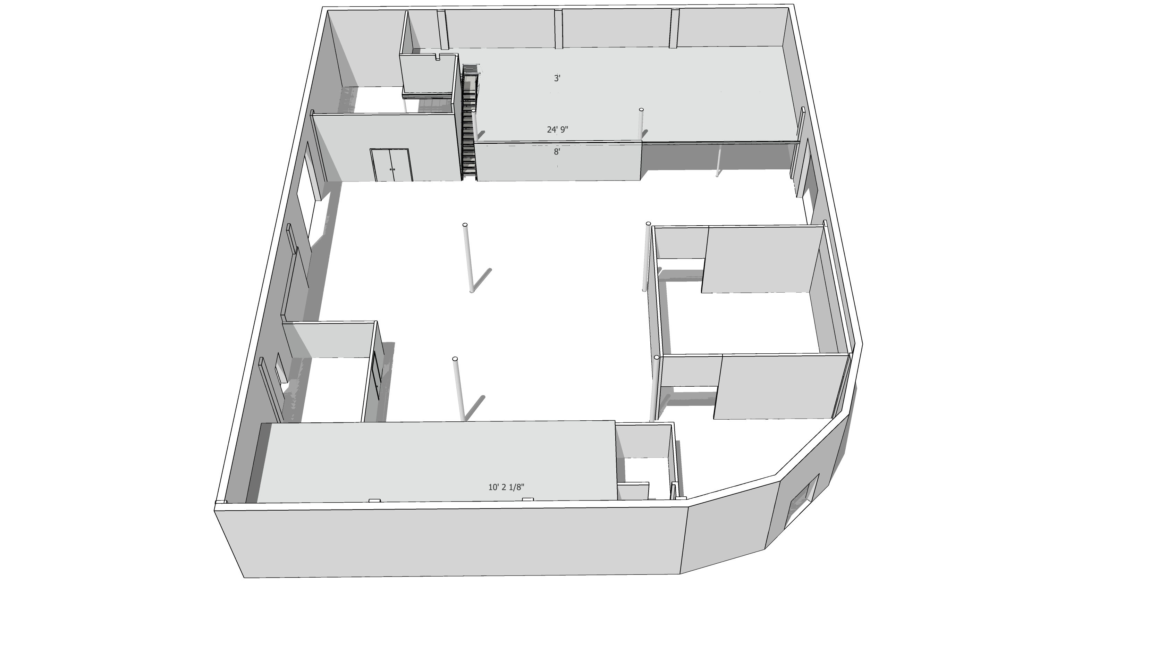
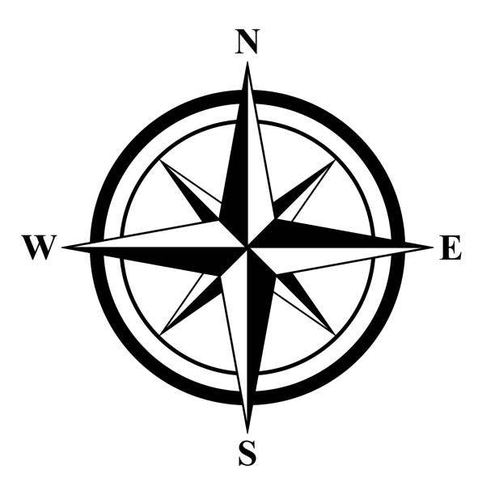
UPPER MEZZANINE: No Access
UNDER MEZZANINE: DiLL
/Screening Room
Wood Shop
Bay door to The Courtyard
Bay door to NE 3rd STREET – Main Gallery does not extend past red dash
MAIN GALLERY
Approx 2,500 SQ. FT.
PROJECT ROOM 625sqft
Courtyard access
UPPER MEZZANINE: two studios
UNDER MEZZANINE: Kitchenette/
Breakroom/ Bathroom
LOBBY
ENTRY / EXIT
2 PUBLIC BATHROOMS

Slide 10
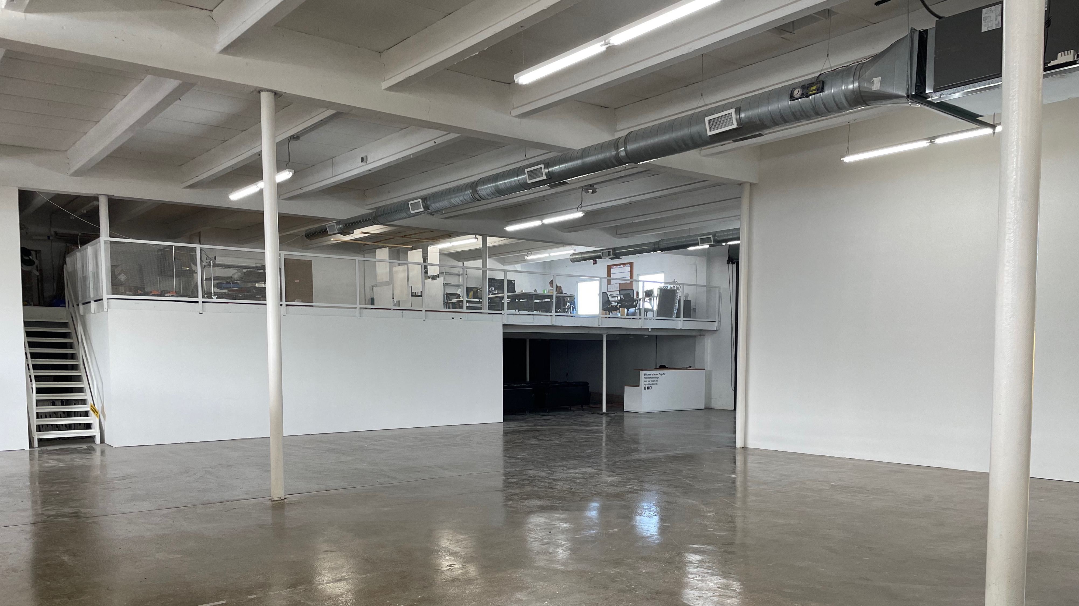

Slide 11
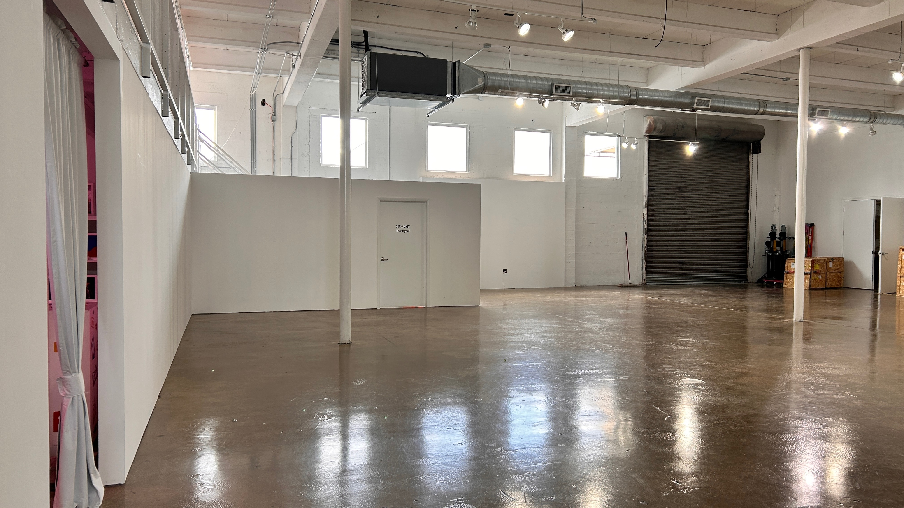

Slide 12
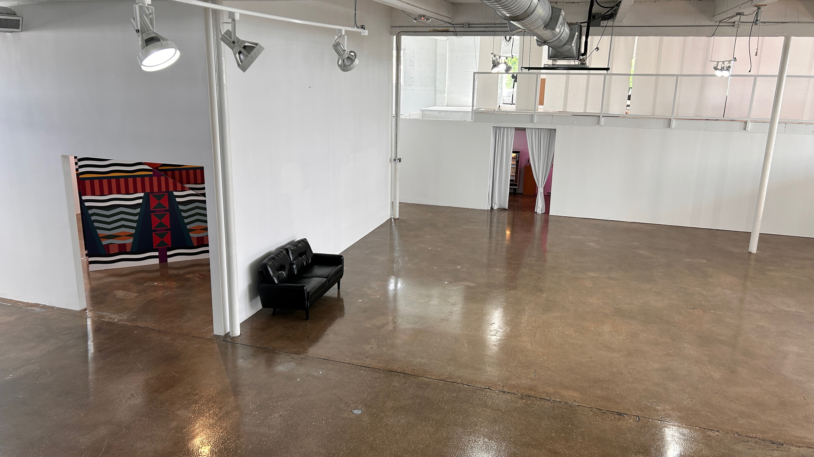

Slide 13
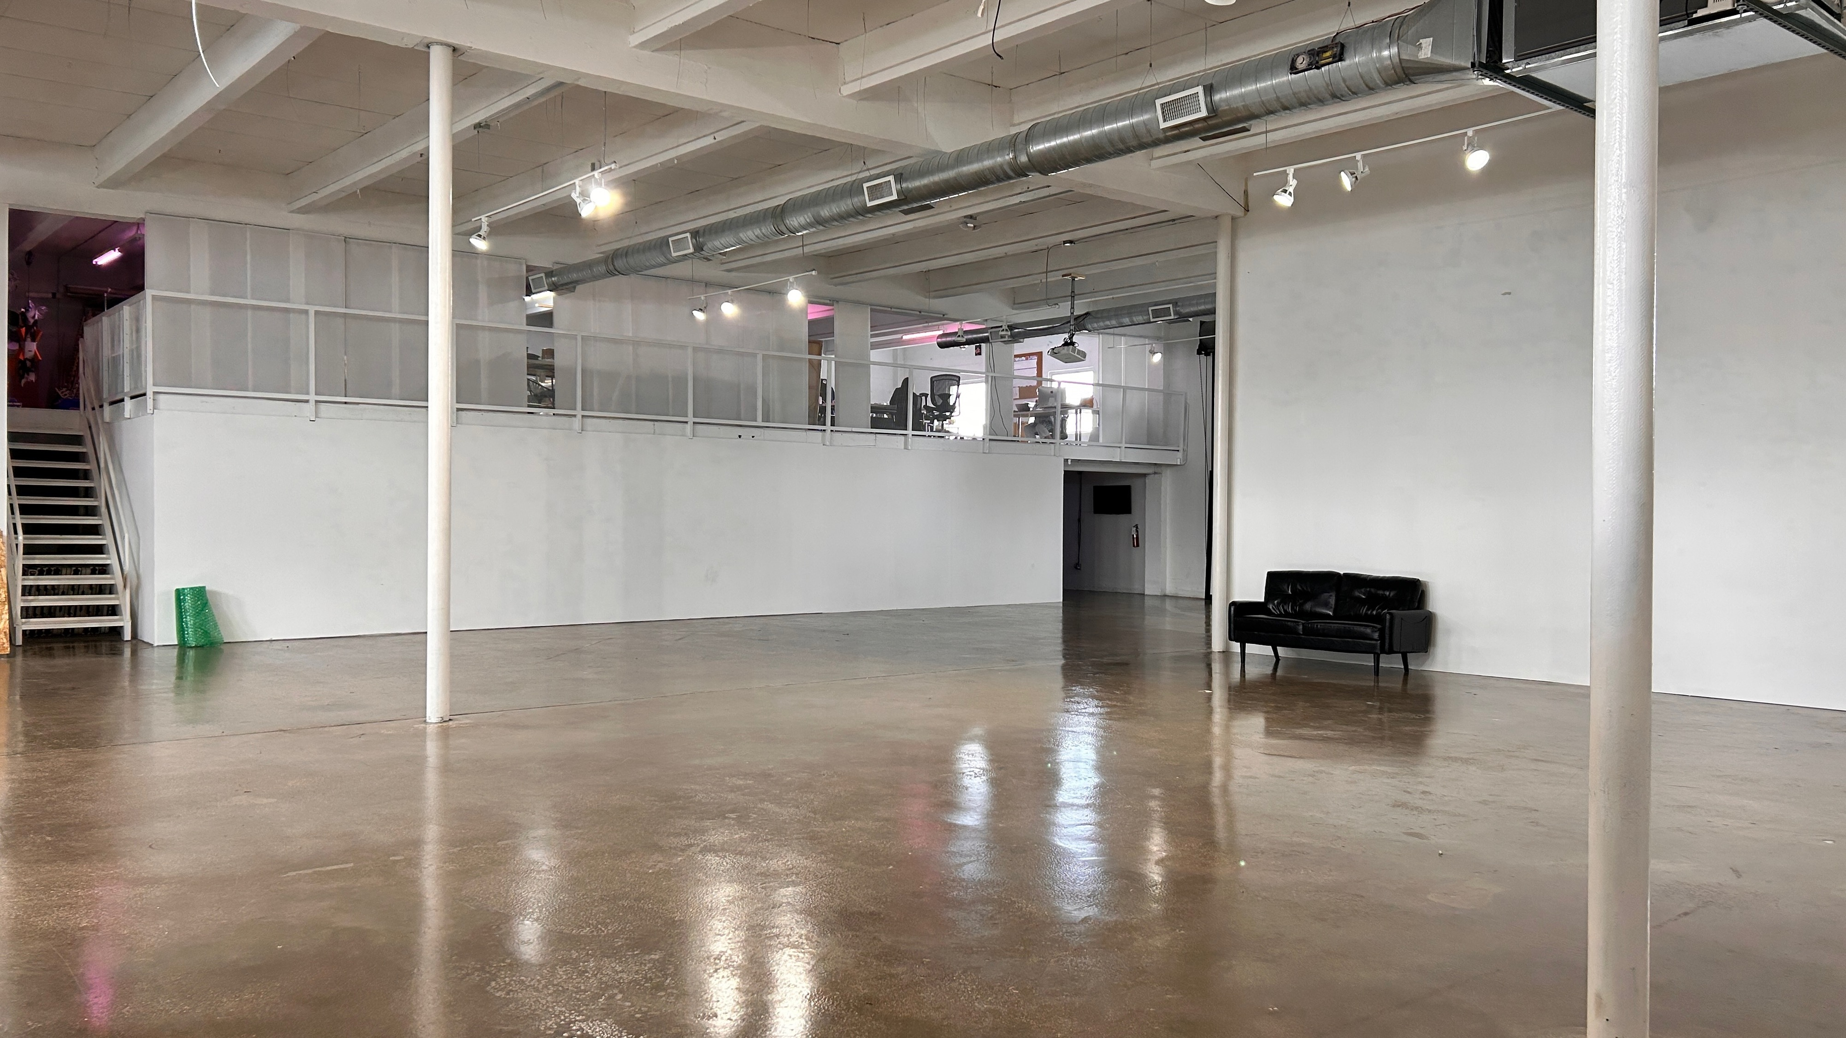

Slide 14
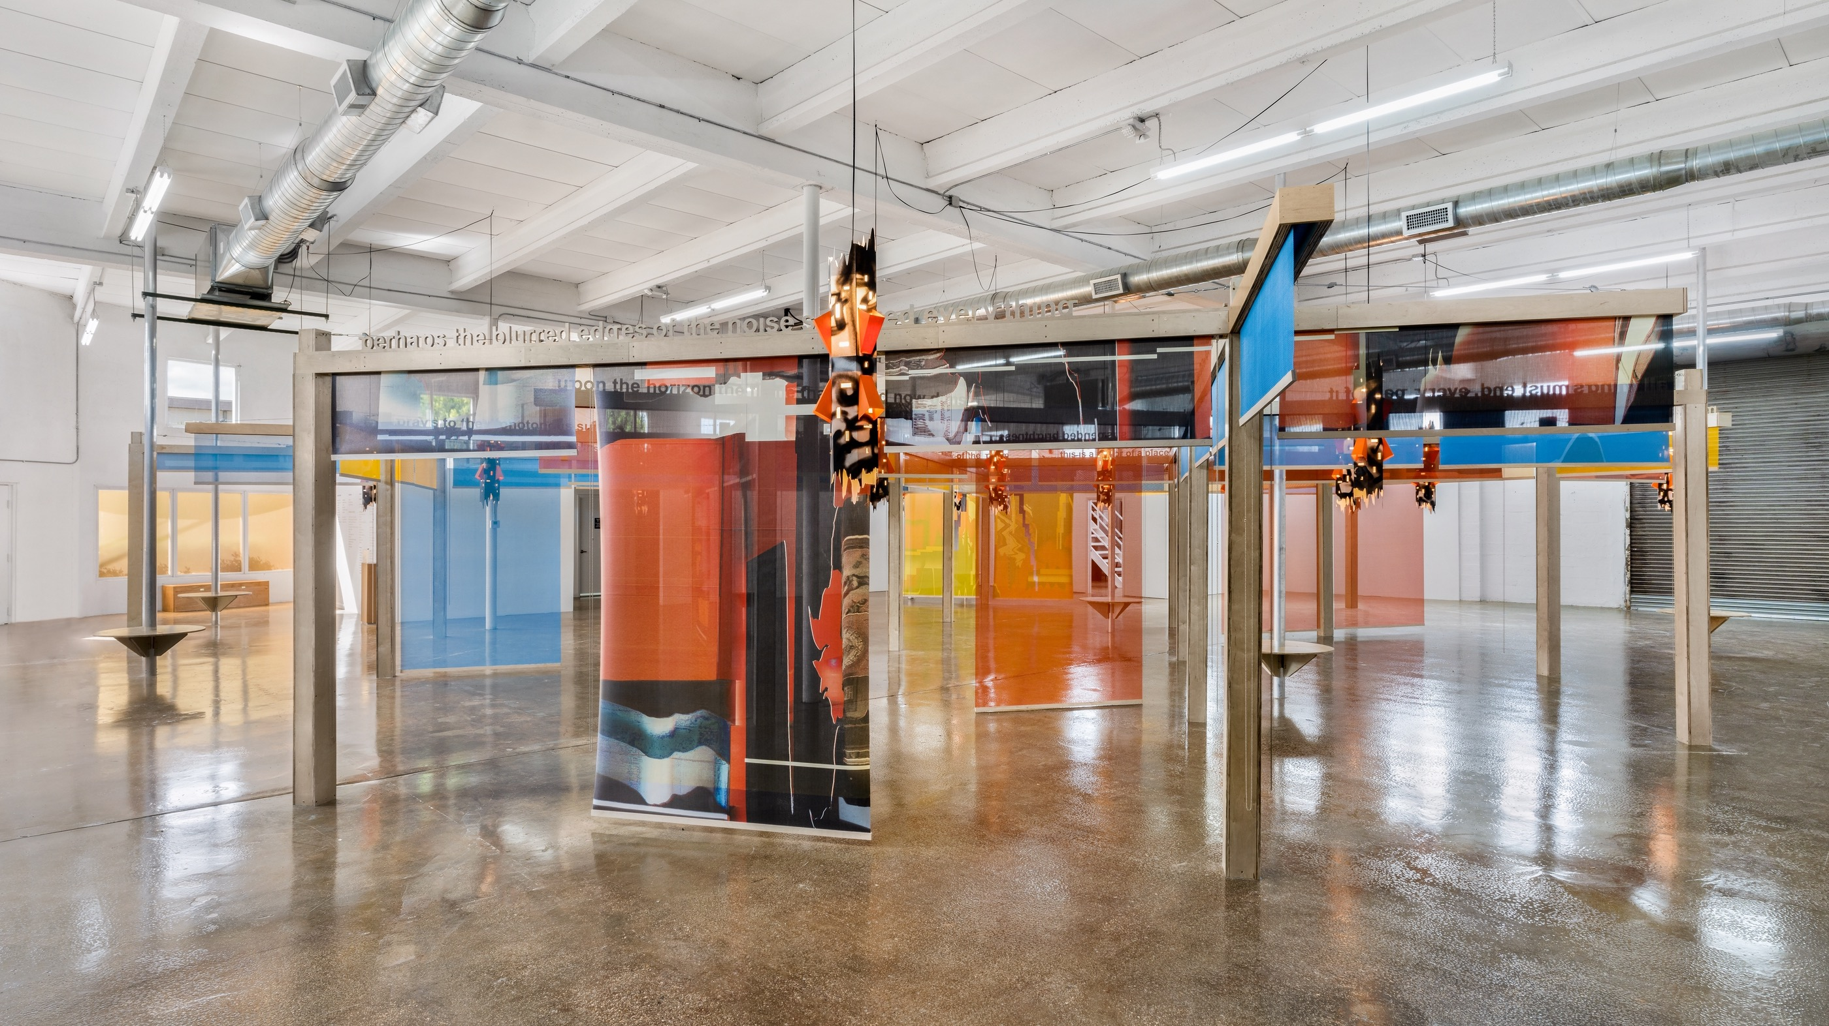

Slide 15
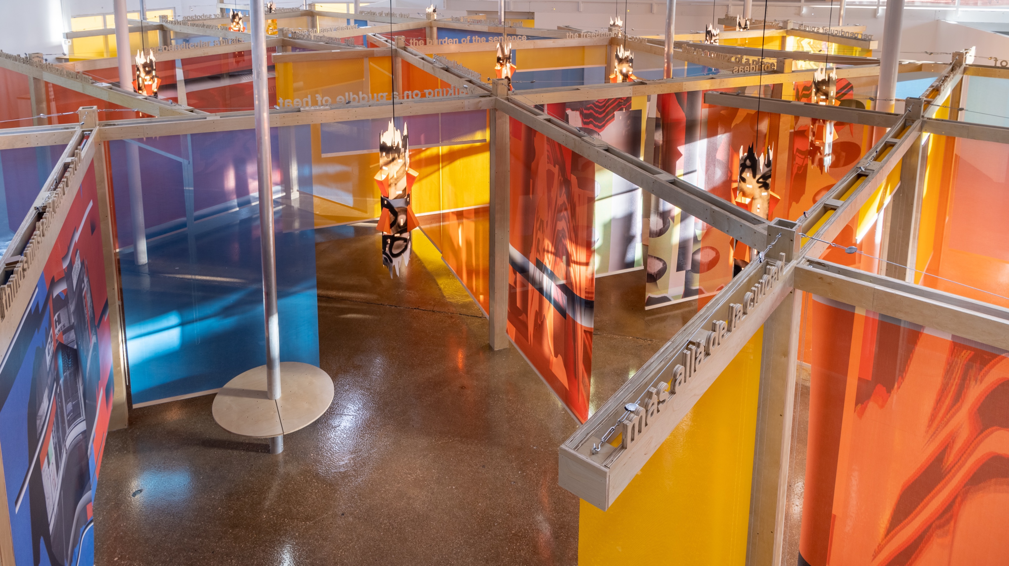

Slide 16
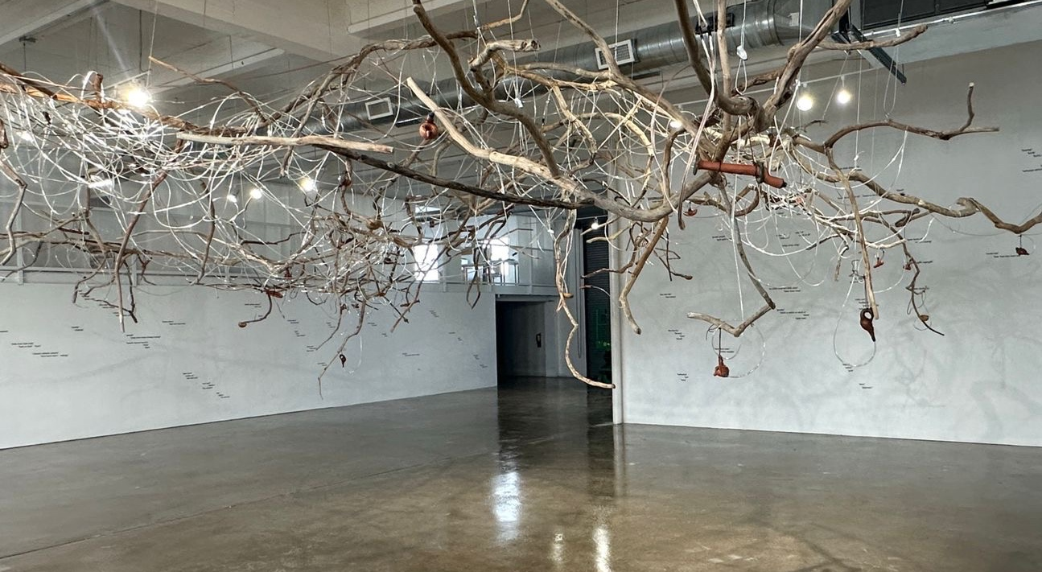

Slide 17
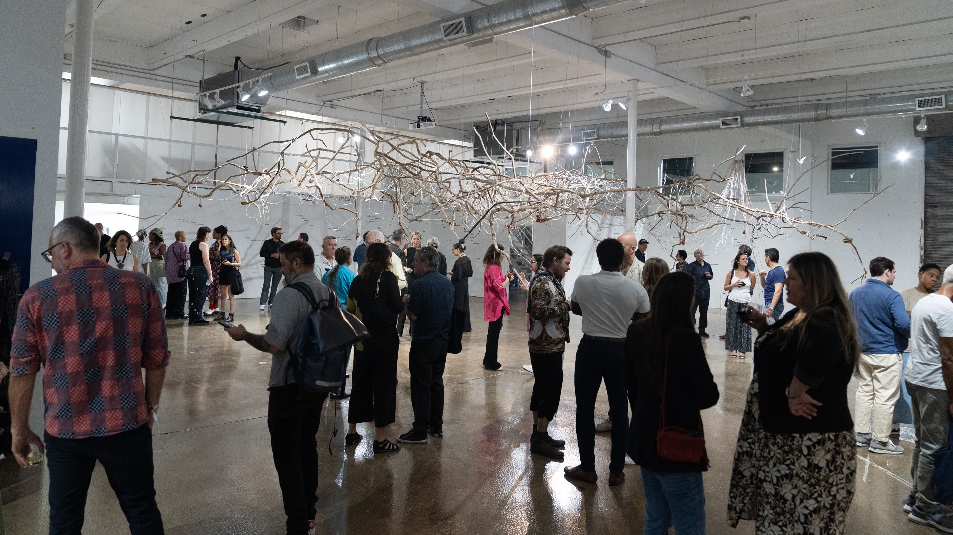

Slide 18
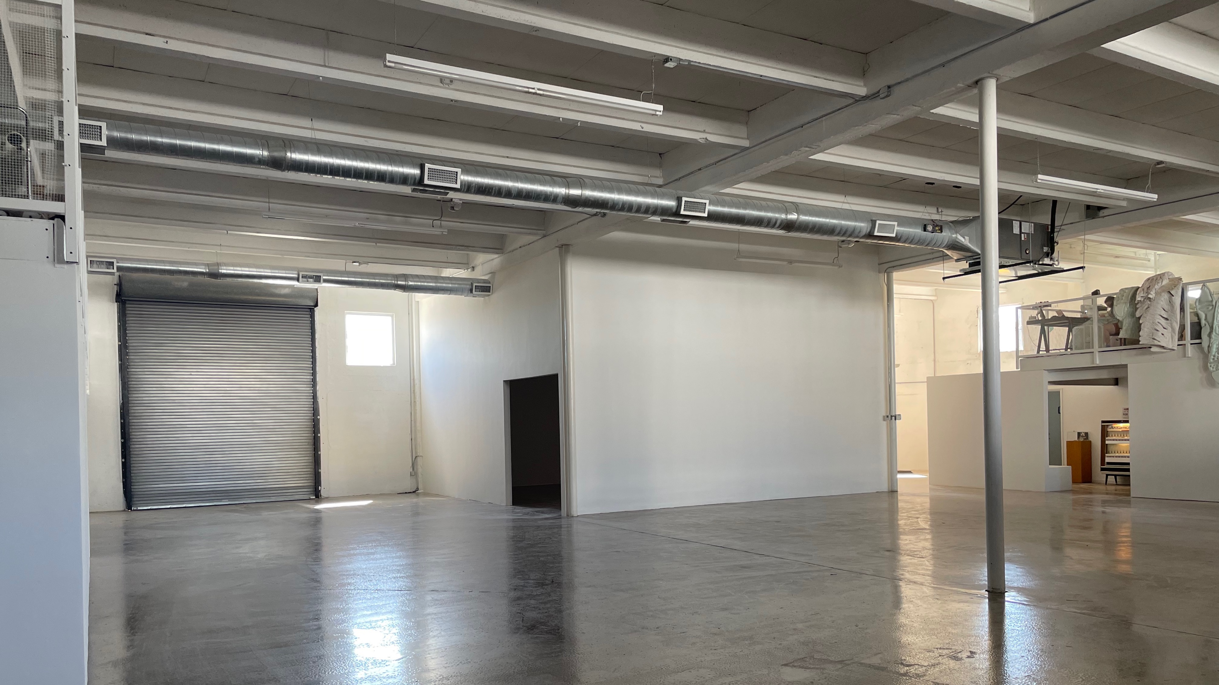
PROJECT ROOM EXTERIOR VIEW FACING EAST

Slide 19
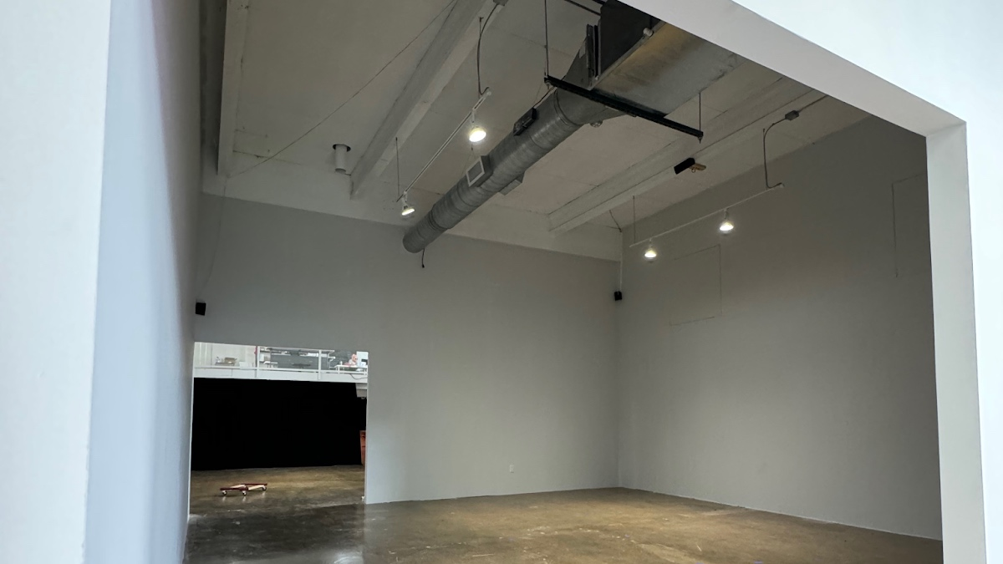
PROJECT ROOM
625 sq ft for immersive installations

Slide 20
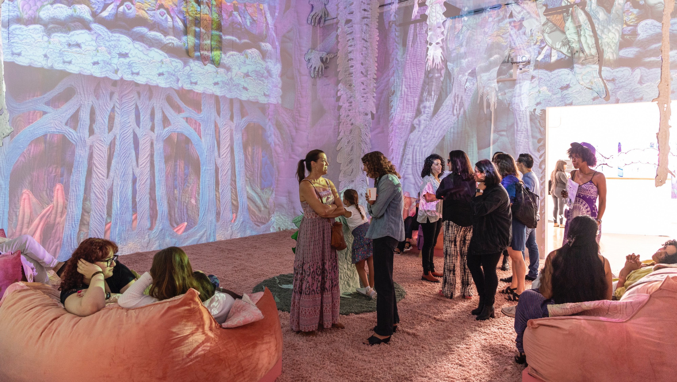

Slide 21
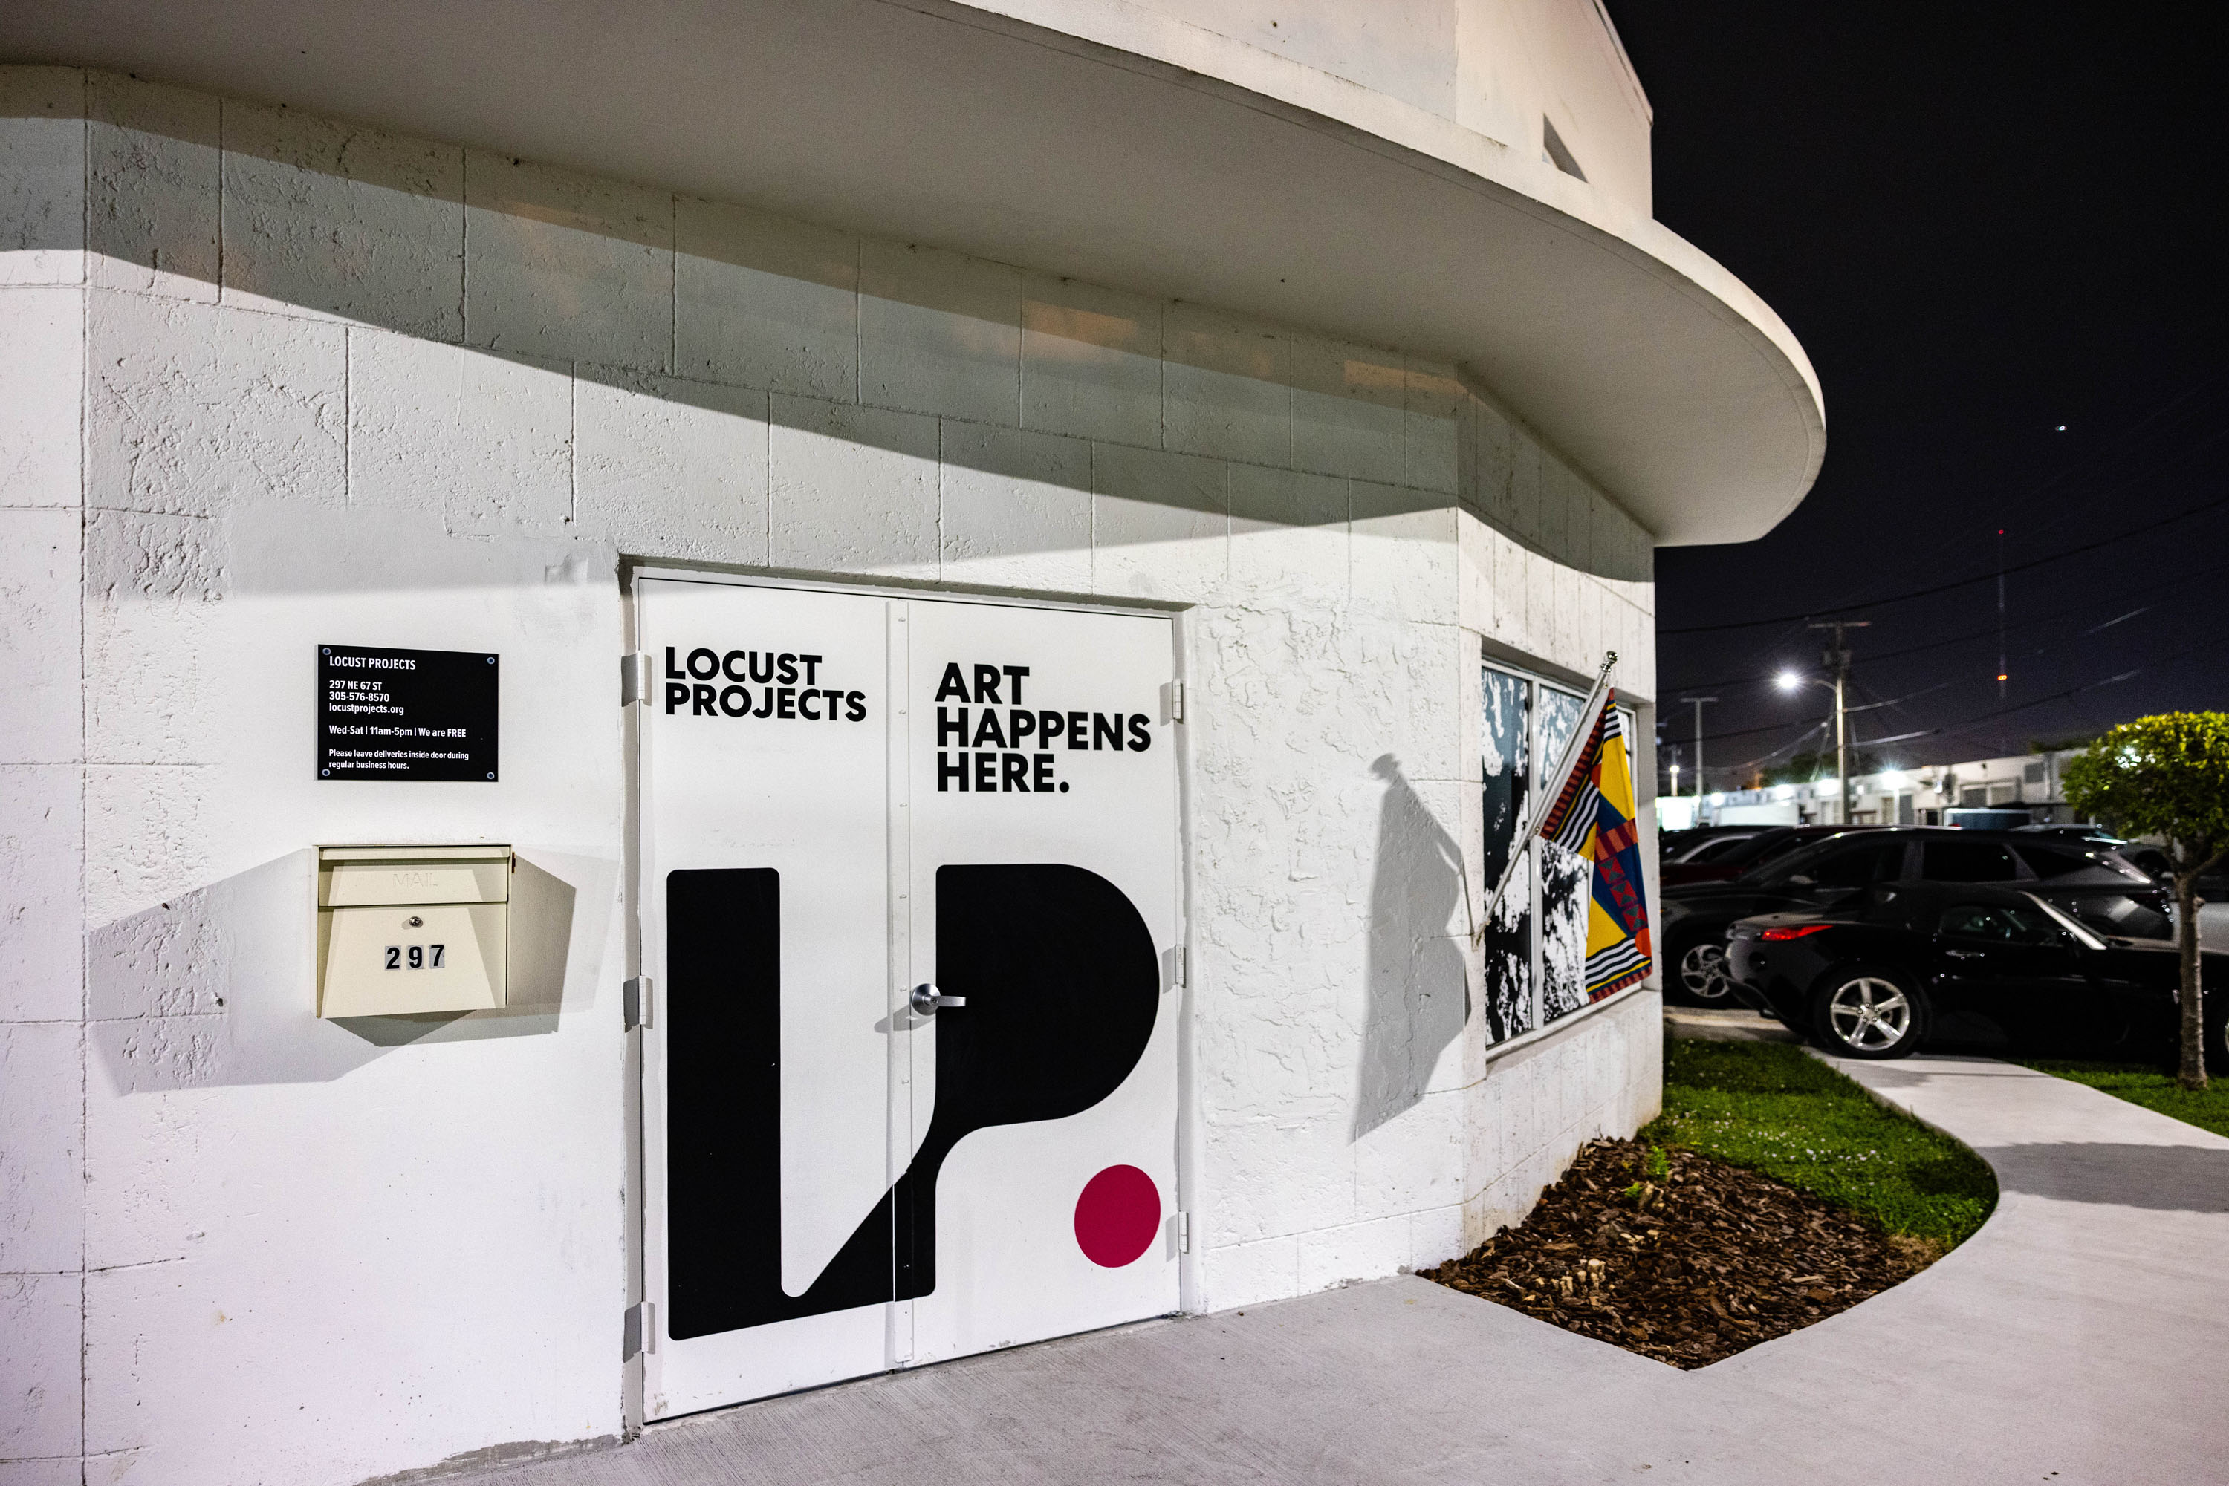
297 NE 67th Street | Miami, FL 33138

